Slide 1


Web Programming 2x1
Working with Variables and Datatypes

Slide 2
Outcomes
Students should understand the following outcomes, upon successful completion of this module:
Storing data in JavaScript
Variables
Manipulations of data in JavaScript

Slide 3
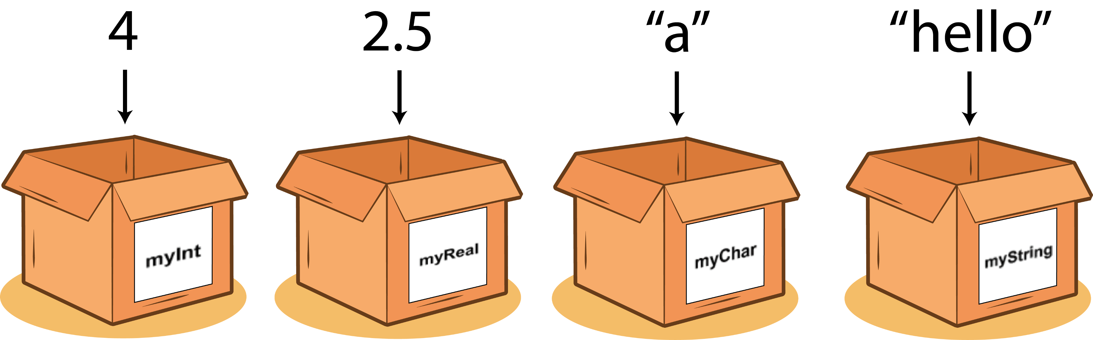
Variables and Data
Storing data so we can use it later is one of the most important things when writing code.
Fortunately, JavaScript can do this!

Slide 4
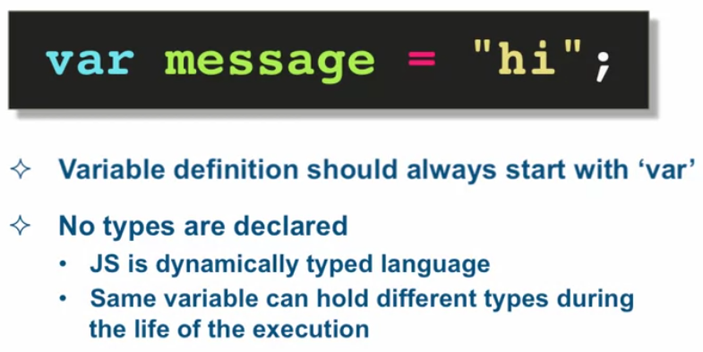
Variables and Data
Variables store data.

Slide 5
Creating Variables
There are two parts to creating a variable; declaration and initialization.
Once it’s created, you can assign (or set) its value.
var a;
Declaration
Assignment of value to variable
var a = 5;
Initialization

Slide 6
Evaluating Variables
A variable is said to be ‘undefined’ if it has been declared, but no value has been given to it.
‘null’ is a value that can be assigned to a variable and represents ‘no value’.
var a;
console.log(a);
var a = null;
console.log(a);
Undefined
null
Therefore, ‘undefined’ is a variable type whereas ‘null’ is an object value.
Notes:
‘Null’ is a keyword in JavaScript that signifies ‘no value’ or nonexistence of any value

Slide 7
Creating Variables
Variables can be used to store strings and numbers (amongst other things), but here the focus is on numbers
var apples = 5, pears = 10;
var totalFruits = apples + pears;
console.log(totalFruits);
Camel casing
Variable names cannot contain spaces.
The names of variables, called identifiers, must start with a letter (A-Z or a-z), underscore (_), or dollar sign ($); subsequent characters can also be digits (0-9).

Slide 8
Data Types
JavaScript variables can hold many data types.
JavaScript is untyped; It does not have explicit data types.
This means that the variable, once declared, can hold a value of any data type
Example:
var age = 20; // Number
var address = "6 Commercial Road"; // String
var fullName = {firstName: "John", lastName: "Doe"}; // Object
console.log( fullName.firstName + " " + fullName.lastName );
console.log("Is aged " + age + " and stays at " + address);

Slide 9
Data Types
Primitive Data Types
Number
Represents both integer and floating-point numbers.
Example: 42, 3.14
Special values: NaN (Not-a-Number), Infinity, -Infinity
2. BigInt
Represents integers with arbitrary precision.
Example: 1234567890123456789012345678901234567890n
Used for large integers beyond the safe integer range for Number type.

Slide 10
3. String
Represents a sequence of characters.
Example: "Hello, World!", 'JavaScript’
4. Boolean
Represents logical values: true or false.
Example: true, false
5. Undefined
Represents a variable that has been declared but not assigned a value.
Example: let x; console.log(x); // undefined

Slide 11
6. Null
Represents the intentional absence of any object value.
Example: let y = null;
7. Symbol
Represents a unique and immutable value, often used for object property keys.
Example: const sym = Symbol('description');

Slide 12
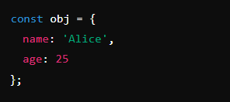
Non-Primitive Data Types (Objects)
1. Object
Represents collections of key-value pairs.
Example:

Slide 13

2. Array
Special type of object for ordered collections of values.
Example:

Slide 14
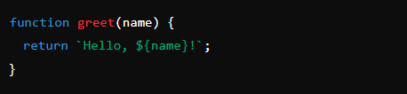
3. Function
Represents callable objects that execute a block of code.
Example

Slide 15

4. Date
Represents date and time.
Example:

Slide 16
Special Objects
Map
Set
weakMap
weakSet

Slide 17
Falsy Values
A falsy value is something which evaluates to FALSE, e.g.: for instance when checking a variable.
There are only six falsy values in JavaScript: undefined, null, NaN, 0, “ " (empty string), and false.
Lets evaluate:
console.log(false == 0);
In JavaScript 0 is a falsy value.
Type coercion will actually convert our zero into a false boolean, then false is equal to false.
Notes:
When using double equals in JavaScript we are testing for loose equality. Double equals also performs type coercion.

Slide 18
Falsy Values
0, “ " (empty string), and false.
console.log(false == 0);
console.log(0 == "");
console.log("" == false);
Evaluate:
When comparing any of our first three falsy values with loose equality, they will always be equal!
That’s because these values will all coerce into a false boolean.
null and undefined
console.log(null == null);
console.log(undefined == undefined);
console.log(null == undefined);
When comparing null and undefined, they are only equal to themselves and each other.
Try to compare null to any other value…?
Evaluate:

Slide 19
Falsy Values
NaN (Not A Number)
Evaluate:
console.log(NaN == null);
console.log(NaN == undefined);
console.log(NaN == false);
console.log(NaN == NaN);
NaN is not equivalent to anything, not even itself!
Triple Equals is superior to double equals.
Whenever possible, you should use triple equals to test equality.
By testing the type and value you can be sure that you are always executing a true equality test.

Slide 20
Thank You!
The End
/belgiumcampusSA
#Belgium Campus
info@belgiumcampus.ac.za
+27 10 593 53 68
/belgiumcampus

